Slide 1
Impedance Control Implementation on UR5e
under ROBOSUITE simulation
——————————————
Jonathan Oh, 941170???
Zitao Yu, 941170755
Project Git: https://github.com/garlicbutter/Jonathan-Tom.git

Slide 2
———————————————
Part 1: Challenge description
Part 2: Simulation Environment
Part 3: Algorithm
Part 4: Experimental Results: Tuning of parameters
Part 5: Performance under assumed best parameters
Part 6: Dicussion and Future Development

Slide 3
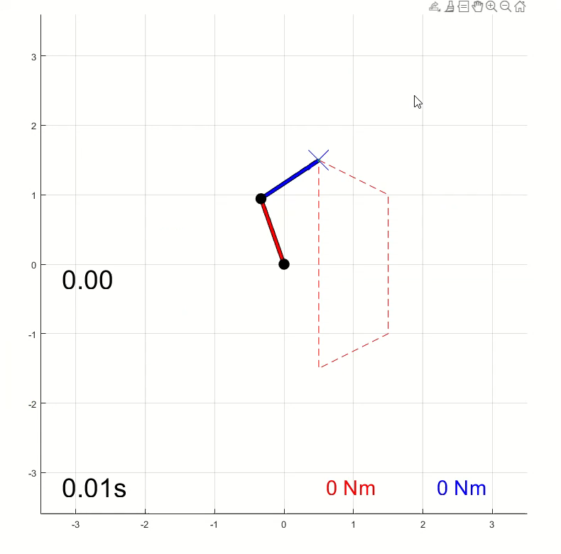
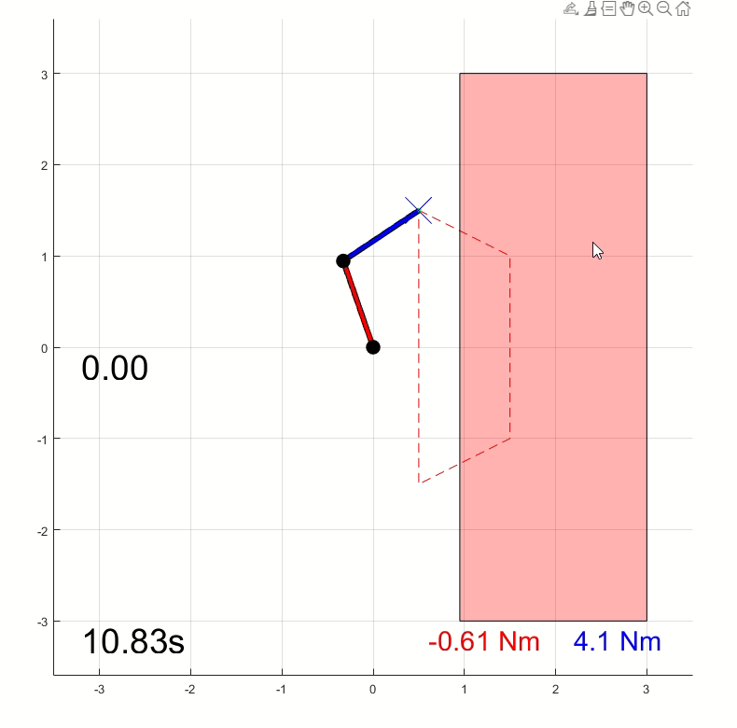
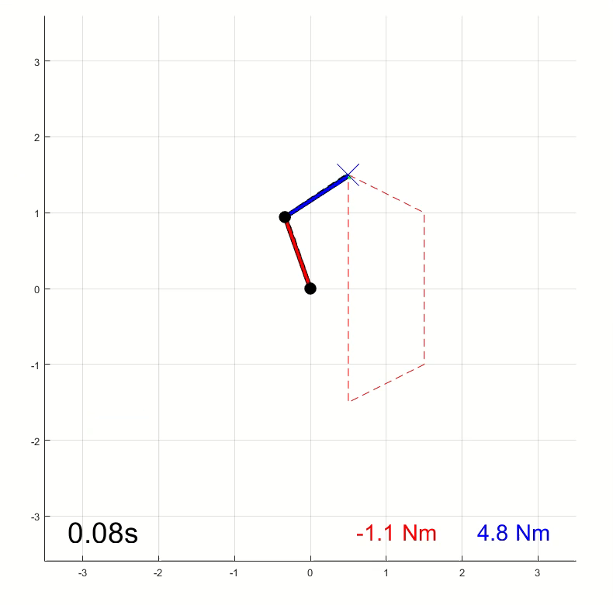
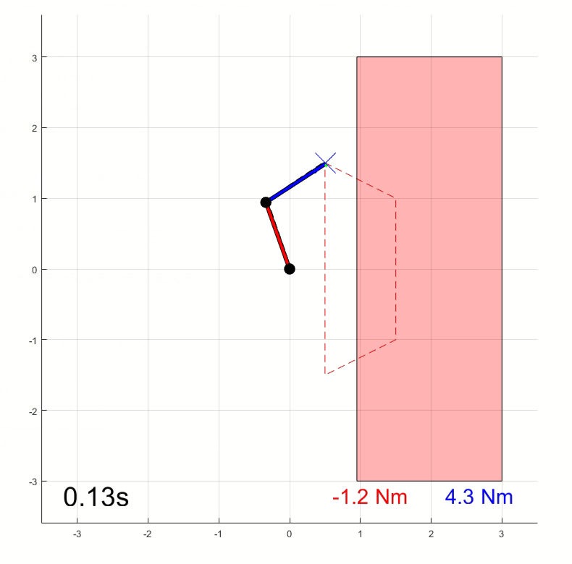
———————————————
Part 1: Challenge description
The insertion operation of robot using traditional PID control:
Might have low robustness when the location of the hole is uncertain
Results in damage in robot arms and working objects.
(impulse in joint load, exceeding maximum material strength, etc)
Need impedance control to avoid such a situation!
Example: Impedance Control on 2R Robotics Arm
DB-IC
PB-IC

Slide 4
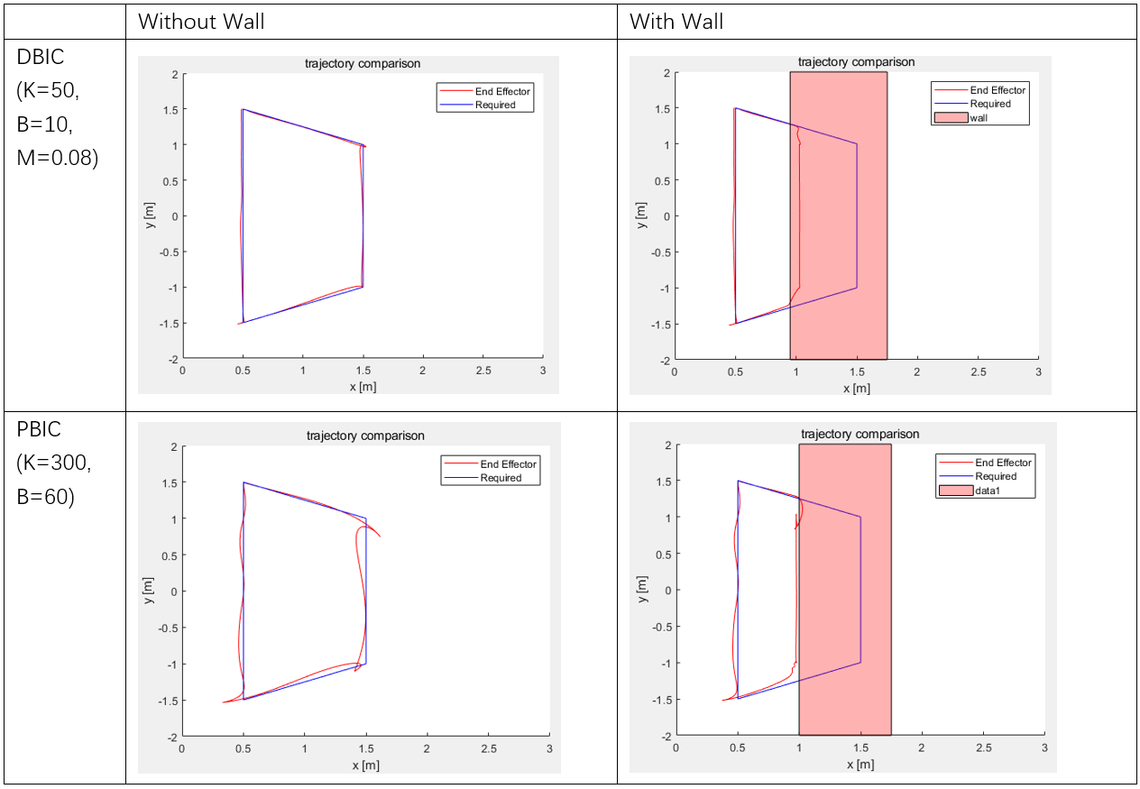
———————————————
Part 1: Challenge description
By tuning of the control parameters, the performance of the movement can be improved.
Impulse of joint value and torque values is decreased.

Slide 5
———————————————
Part 2: Simulation Environment
Simulation Software: Robosuite .
Robosuite is a simulation framework powered by the MuJoCo physics engine for robot learning. It also offers a suite of benchmark environments for reproducible research. This project is part of the broader Advancing Robot Intelligence through Simulated Environments (ARISE) Initiative, with the aim of lowering the barriers of entry for cutting-edge research at the intersection of AI and Robotics.
Installation Reference:
https://robosuite.ai/docs/installation.html
https://github.com/openai/mujoco-py
Task model:
16mm diameter aluminum rod
Rectanguar hole
(add picture of the initial posture)
Trajectory planning
Pick – and – place process, in order to do multiple tasks if needed

Slide 6
———————————————
Part 3: Algorithm
Impedance control
DBIC & PBIC
Advantages: Easy to derivate
Disadvantages: Hard to implement in Robosuite environment, force sensor might be very noisy
Operational Space Control with fixed impedance
Algorithm does not need the force sensor in the tool, so the hardness with implementing force sensor in Robosuite simulation won’t affact us.
Fixed impedance allows us to have an easier tuning process. (The impedance can then be flexible with learning algorithm to have better performance in more general cases.)

Slide 7
———————————————
Part 4: Experimental Results: Tuning of parameters
4.1 To test range of parameters for successful insertion
Criteria:
Run time: consider exceeding 30s as failure, to achieve a more effective control.
External force in x, y, z direction: applying the impedance control, the reaction force changes more smoothly, and the maximum force is not too high.
Variables
Kp & Kd in x,y,z prismatic and torsional directions
Perception error (dislocation of the hole as percentage of the diameter of the rod)
——————————

Slide 8
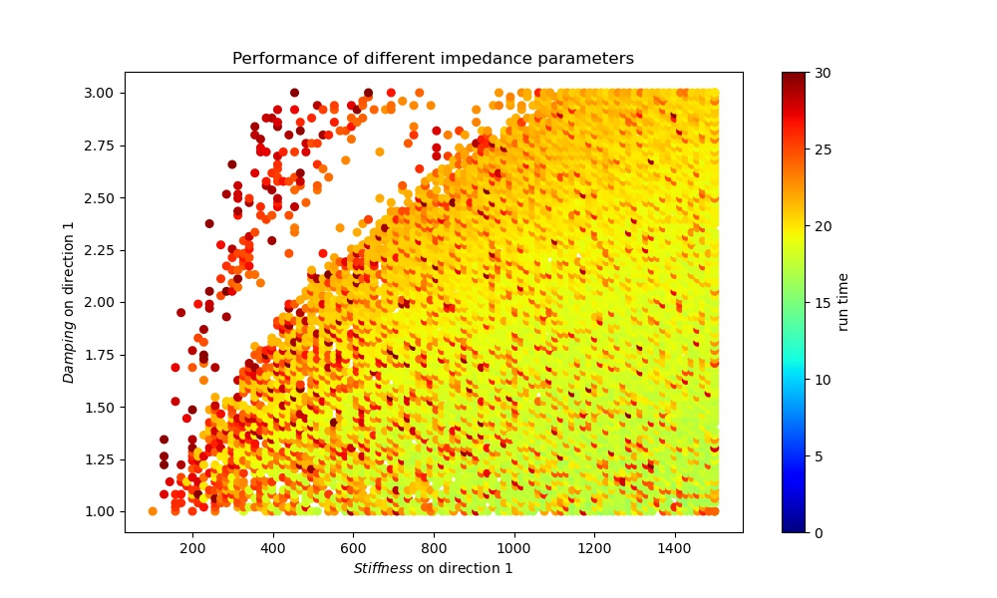
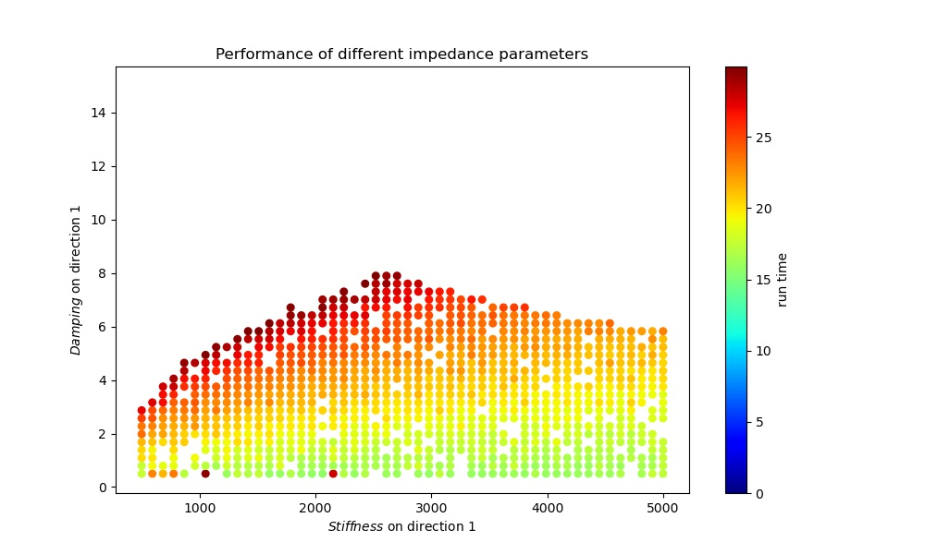
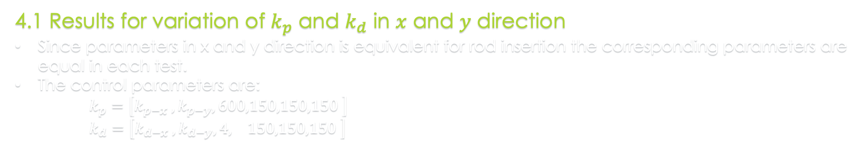


———————————————
Part 4: Experimental Results: Tuning of parameters
4.1 Results for variation of $k_{p}$ and $k_{d}$ in $x$ and $y$ direction
Since parameters in x and y direction is equivalent for rod insertion the corresponding parameters are equal in each test.
The control parameters are:
$k_{p}=\left[k_{p−x} ,k_{p−y},600,150,150,150 \right]$
$k_{d}=\left[k_{d−x} ,k_{d−y},4, 150,150,150 \right]$
$k_{p−x,y}∈\left[100,1500\right], k_{d−x,y}∈\left[1,3\right]$
$k_{p−x,y}∈\left[500,5000\right], k_{d−x,y}∈\left[1,15\right]$

Slide 9
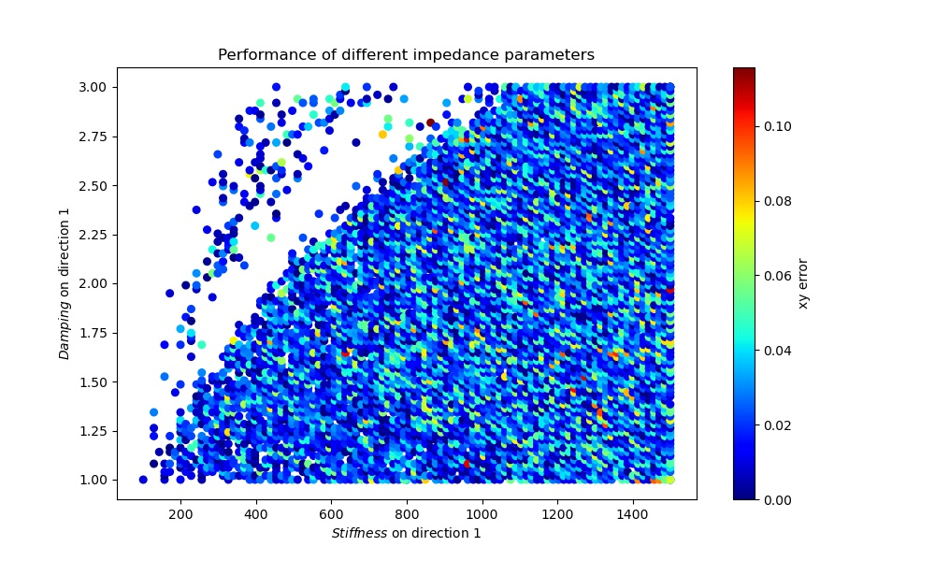
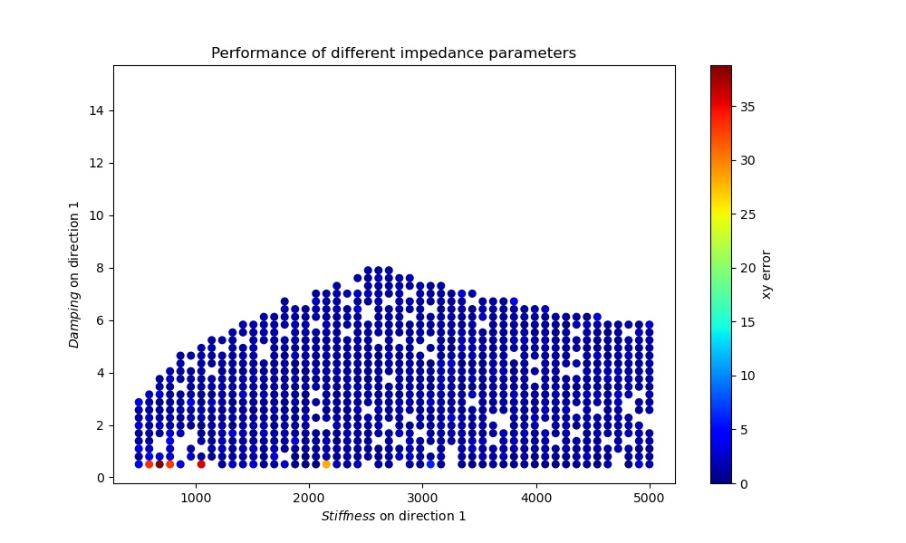
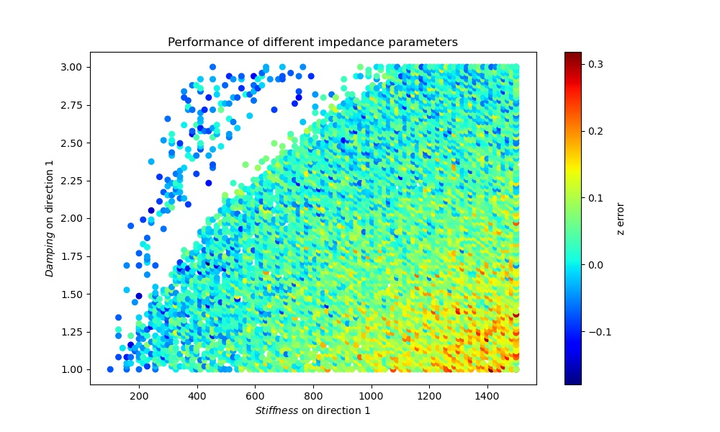


———————————————
Part 4: Experimental Results: Tuning of parameters
$k_{p−x,y}∈\left[500,5000\right], k_{d−x,y}∈\left[1,15\right]$
$k_{p−x,y}∈\left[500,5000\right], k_{d−x,y}∈\left[1,15\right]$
(xy/z error: maximums of the external forces in x-y/z direction)

Slide 10
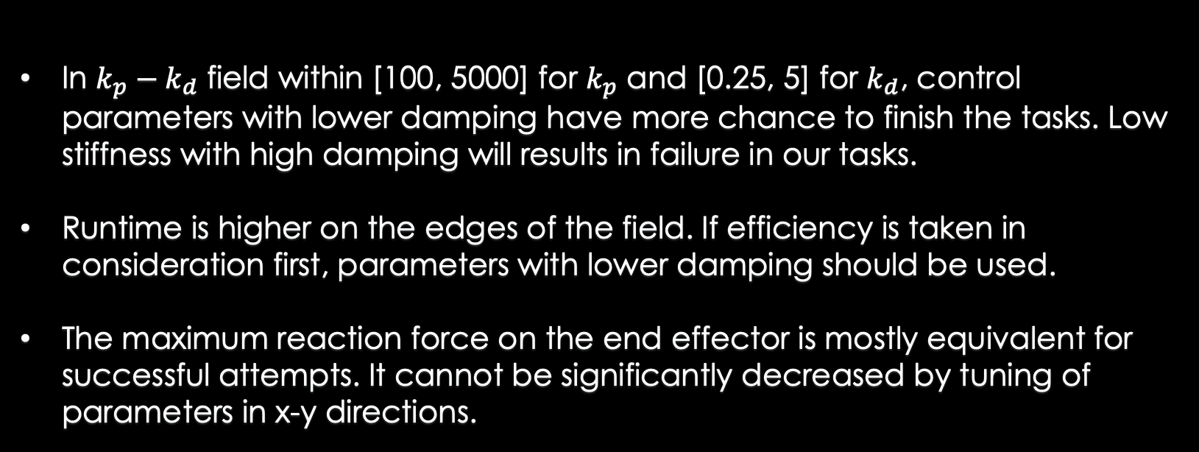
———————————————
Part 4: Experimental Results: Tuning of parameters
4.1 Results for variation of $k_{p}$ and $k_{d}$ in $x$ and $y$ direction
In $k_{p}−k_{d}$ field within [100, 5000] for $k_{p}$ and [0.25, 5] for $k_{d}$, control parameters with lower damping have more chance to finish the tasks. Low stiffness with high damping will results in failure in our tasks.
Runtime is higher on the edges of the field. If efficiency is taken in consideration first, parameters with lower damping should be used.
The maximum reaction force on the end effector is mostly equivalent for successful attempts. It cannot be significantly decreased by tuning of parameters in x-y directions.

Slide 11
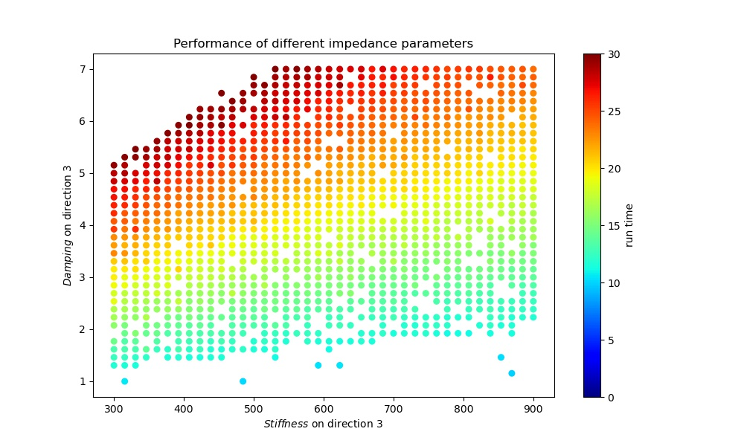
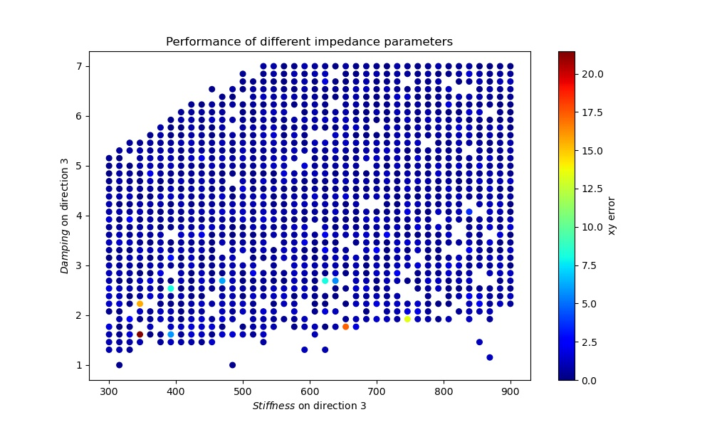


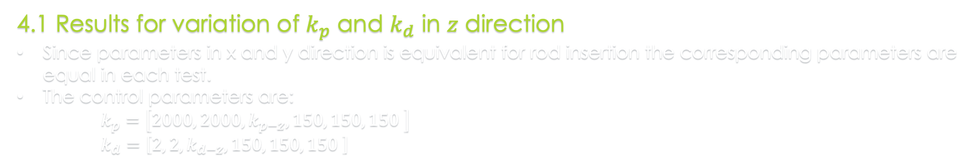
———————————————
Part 4: Experimental Results: Tuning of parameters
4.1 Results for variation of $k_{p}$ and $k_{d}$ in $z$ direction
Since parameters in x and y direction is equivalent for rod insertion the corresponding parameters are equal in each test.
The control parameters are:
$k_{p}=\left[2000, 2000,k_{p−z}, 150, 150, 150 \right]$
$k_{d}=\left[2, 2,k_{d−z}, 150, 150, 150 \right]$
$k_{p−z}∈\left[300,900\right], k_{p−z}∈\left[1,7\right]$

Slide 12
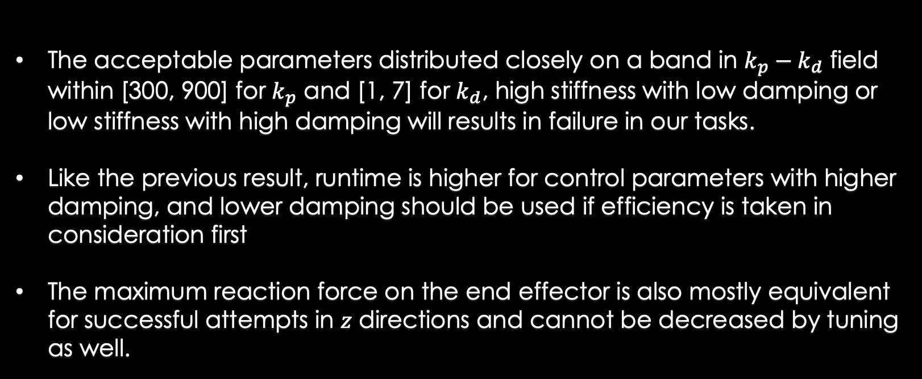
———————————————
Part 4: Experimental Results: Tuning of parameters
4.1 Results for variation of $k_{p}$ and $k_{d}$ in $z$ direction
The acceptable parameters distributed closely on a band in $k_{p}−k_{d}$ field within [300, 900] for $k_{p}$ and [1, 7] for $k_{d}$, high stiffness with low damping or low stiffness with high damping will results in failure in our tasks.
Like the previous result, runtime is higher for control parameters with higher damping, and lower damping should be used if efficiency is taken in consideration first
The maximum reaction force on the end effector is also mostly equivalent for successful attempts in $z$ directions and cannot be decreased by tuning as well.

Slide 13
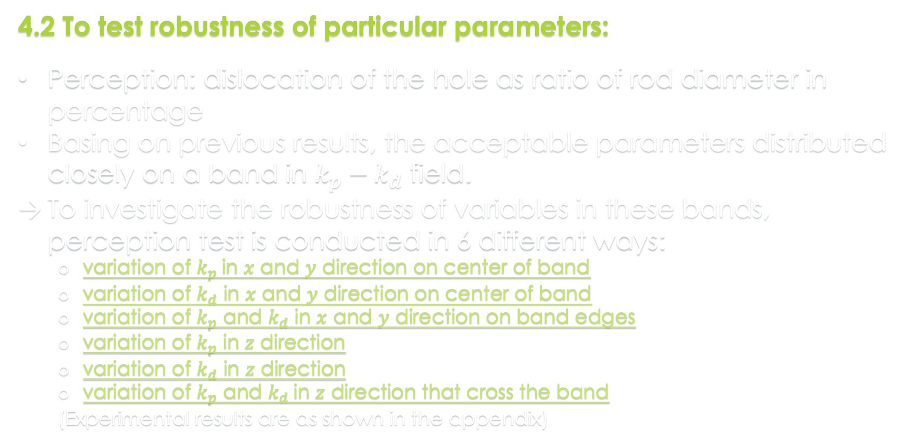
———————————————
Part 4: Experimental Results: Tuning of parameters
4.2 To test robustness of particular parameters:
Perception: dislocation of the hole as ratio of rod diameter in percentage
Basing on previous results, the acceptable parameters distributed closely on a band in $k_{p}−k_{d}$ field.
To investigate the robustness of variables in these bands, perception test is conducted in 6 different ways:
variation of $k_{p}$in $x$ and $y$ direction on center of band
variation of $k_{d}$ in $x$ and $y$ direction on center of band
variation of $k_{p}$ and $k_{d}$ in $x$ and $y$ direction on band edges
variation of $k_{p}$ in $z$ direction
variation of $k_{d}$ in $z$ direction
variation of $k_{p}$ and $k_{d}$in $z$ direction that cross the band
(Experimental results are as shown in the appendix)

Slide 14

———————————————
Part 4: Experimental Results: Tuning of parameters
4.2 To test robustness of particular parameters:
Lower stiffness and Higher damping results in higher tolerance to perception error in all $x, y$ and $z$ direction.
For both of the band-like parameter ranges, the tolerance is much better on the center of the band.
Perception error significantly increase the maximum force on the $x,y$ and $z$ directions. This might be a limit of the control method.

Slide 15
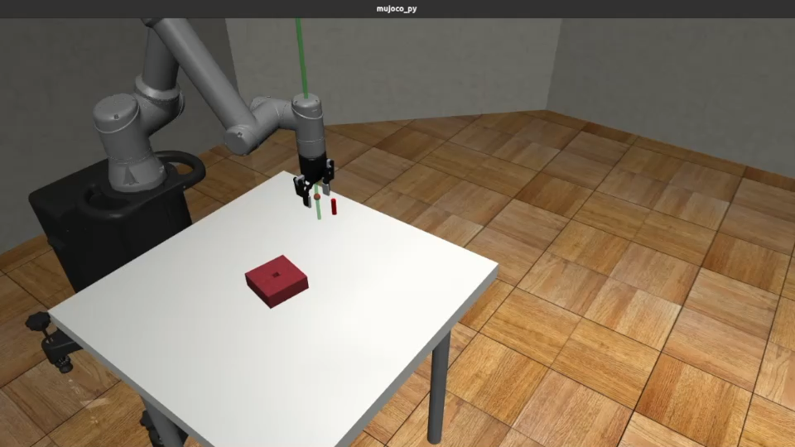


———————————————
Part 5: Performance under assumed best parameters
$k_{p}$= $\left[2000 ,2000, 600, 150, 150, 150\right]$
$k_{d}$= $\left[2, 2, 4, 150, 150, 150 \right]$

Slide 16
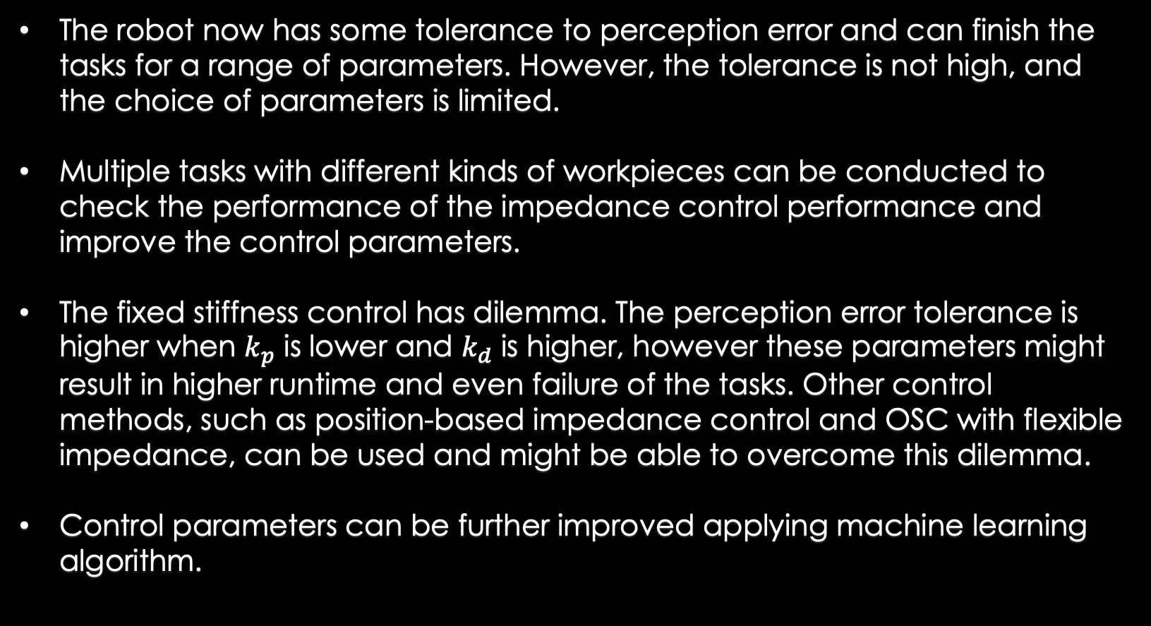
———————————————
Part 6: Discussion and Future Development
The robot now has some tolerance to perception error and can finish the tasks for a range of parameters. However, the tolerance is not high, and the choice of parameters is limited.
Multiple tasks with different kinds of workpieces can be conducted to check the performance of the impedance control performance and improve the control parameters.
The fixed stiffness control has dilemma. The perception error tolerance is higher when $k_{p}$ is lower and $k_{d}$ is higher, however these parameters might result in higher runtime and even failure of the tasks. Other control methods, such as position-based impedance control and OSC with flexible impedance, can be used and might be able to overcome this dilemma.
Control parameters can be further improved applying machine learning algorithm.

Slide 17
Impedance Control Implementation on UR5e
under ROBOSUITE simulation
Questions
_____________________

Slide 18
Impedance Control Implementation on UR5e
under ROBOSUITE simulation
Thank You!
_____________________

Slide 19
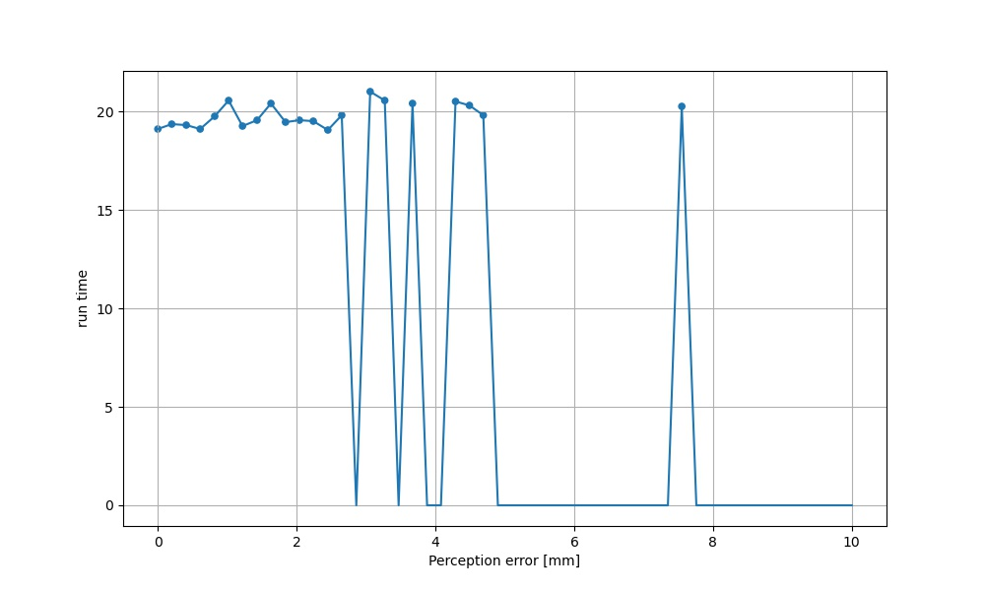
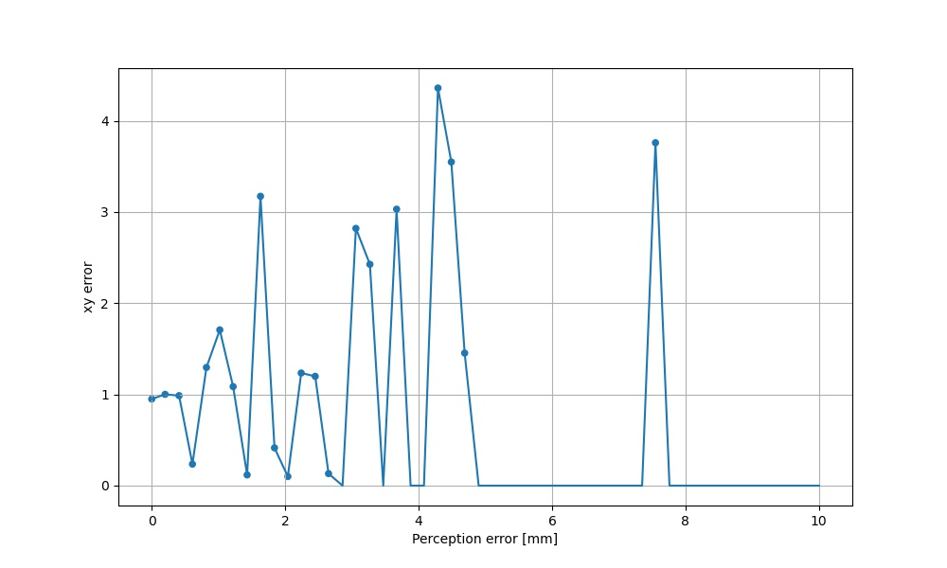
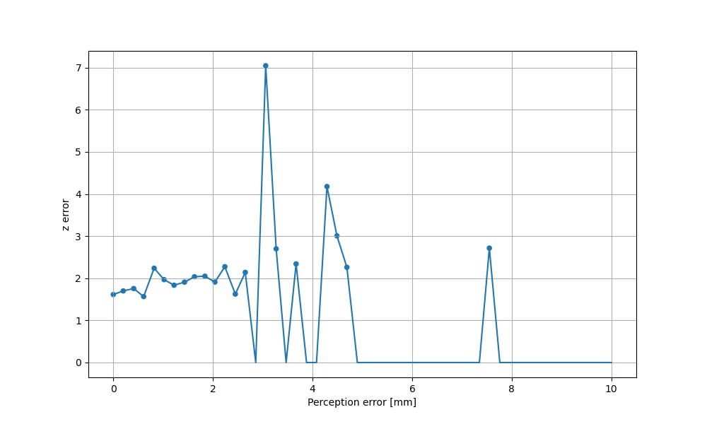
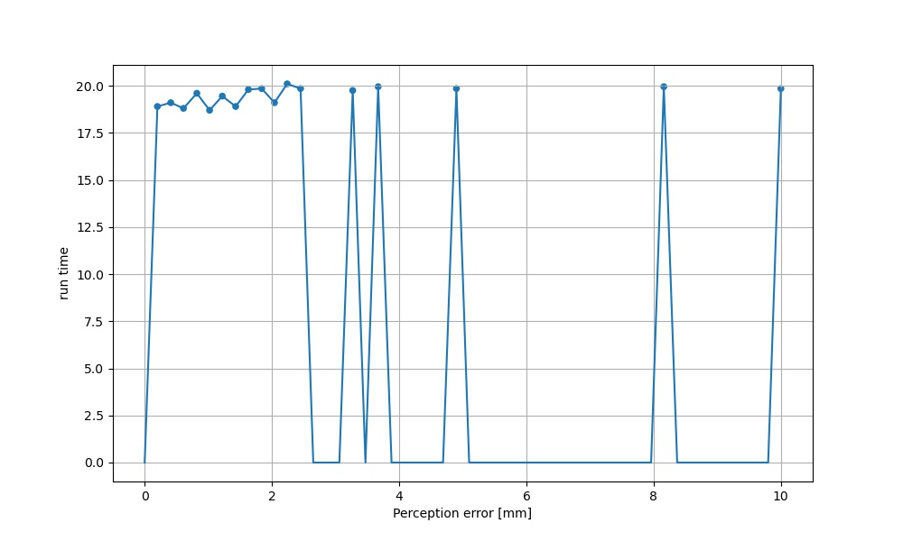
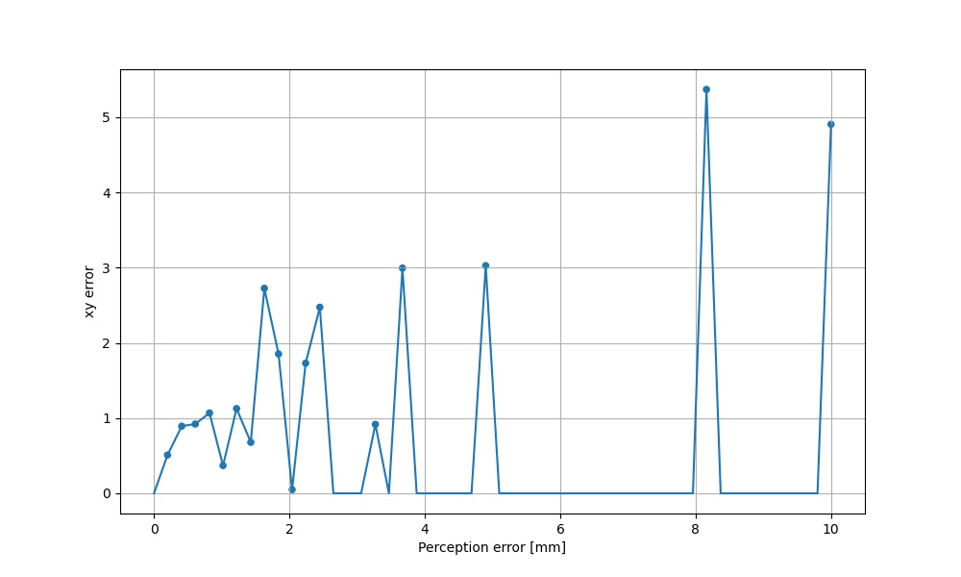
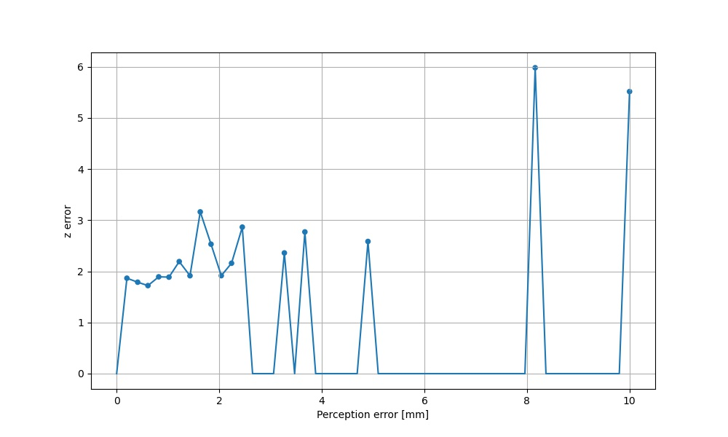
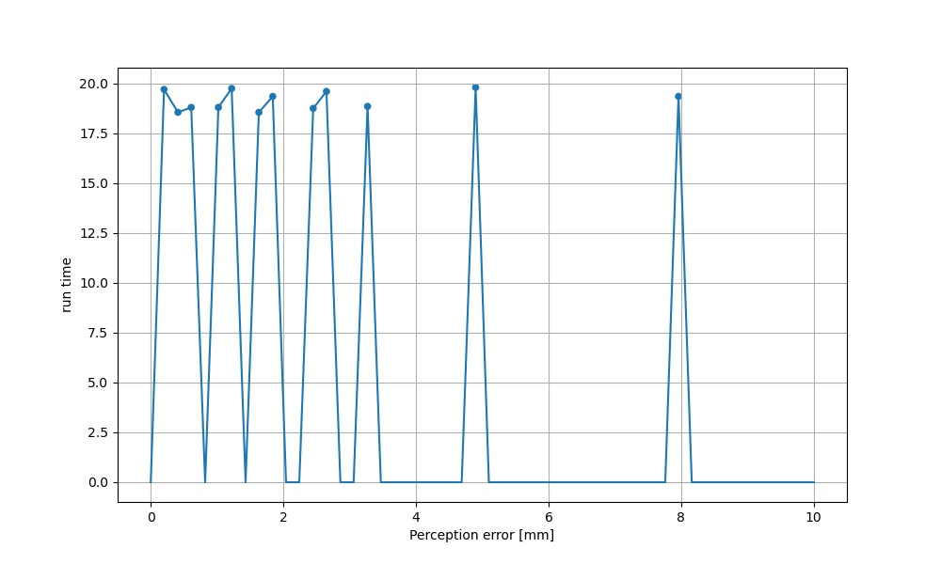
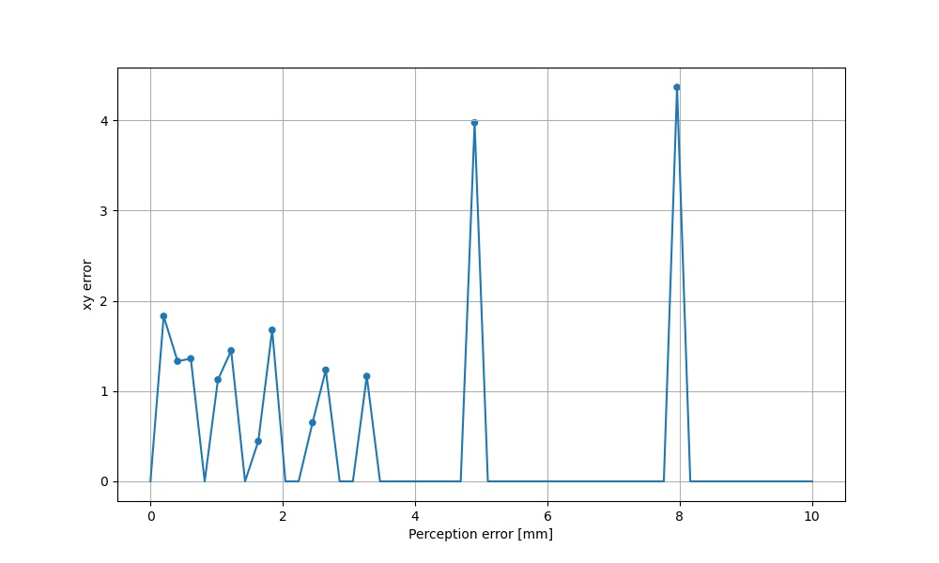
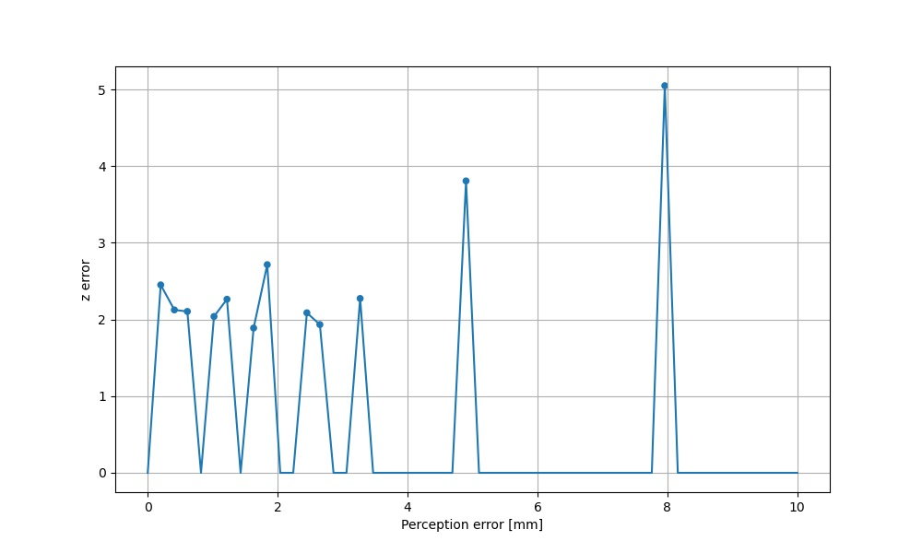
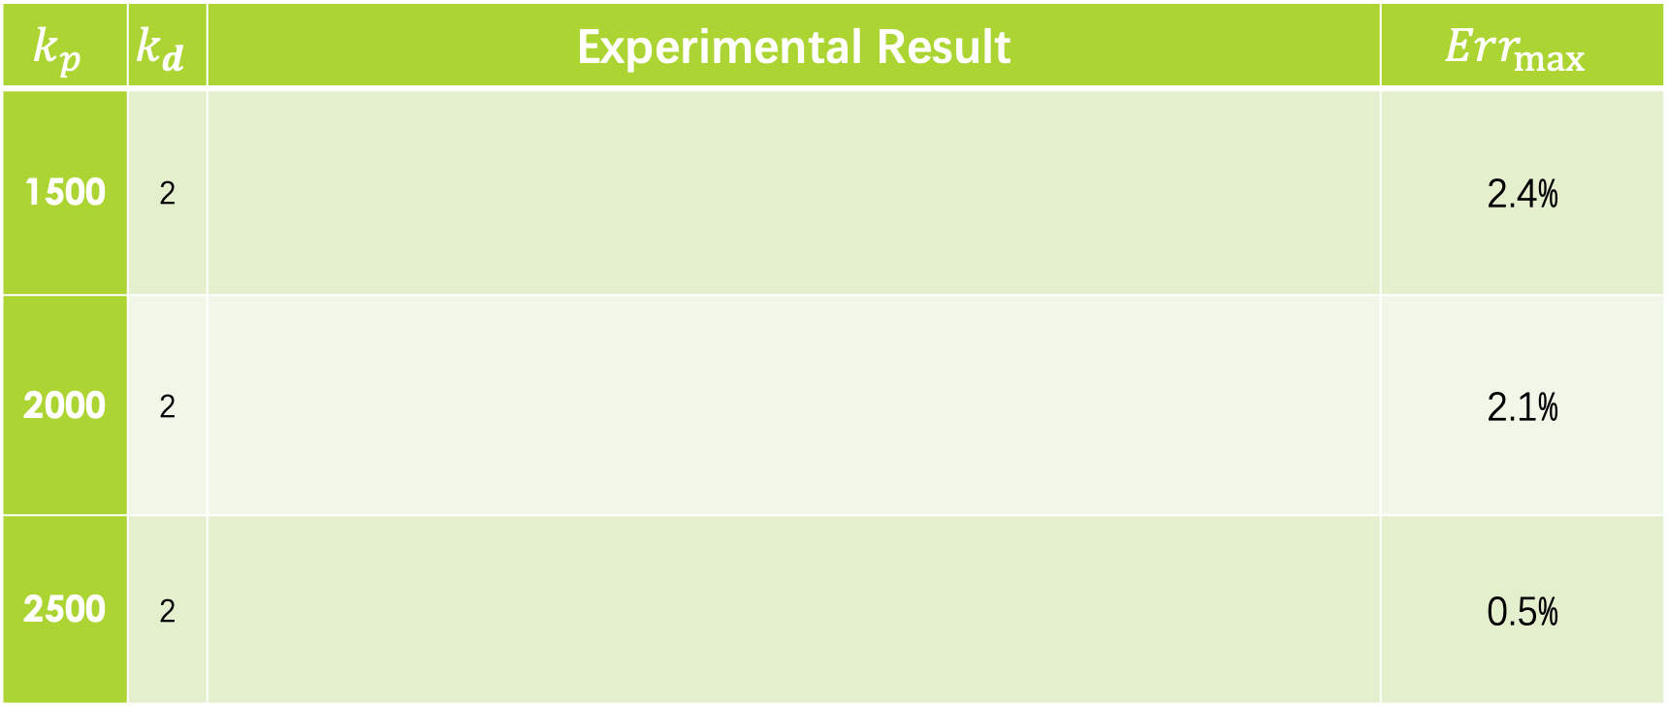
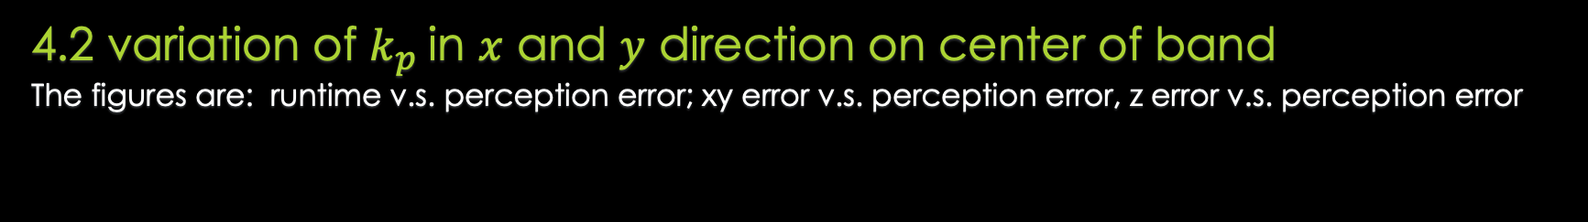
———————————————
Part 4: Experimental Results – Appendix
4.2 variation of $k_{p}$in $x$ and $y$ direction on center of band
The figures are: runtime v.s. perception error; xy error v.s. perception error, z error v.s. perception error
$$k_{p}$$ | $$k_{d}$$ | Experimental Result | $$Err_{max}$$
1500 | 2 |  | 2.4%
2000 | 2 |  | 2.1%
2500 | 2 |  | 0.5%

Slide 20
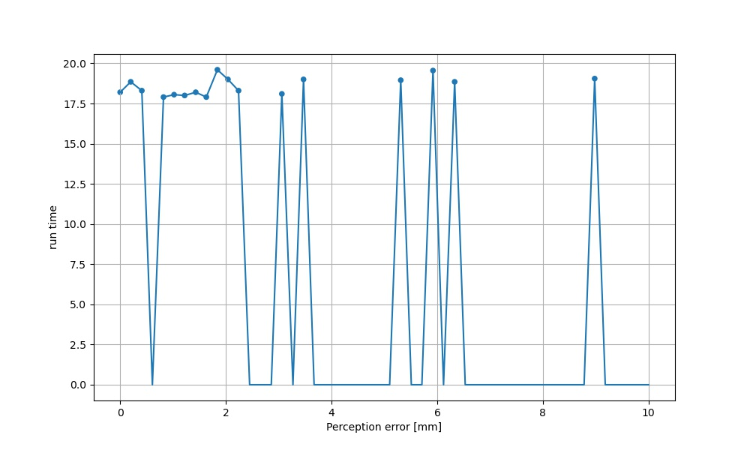
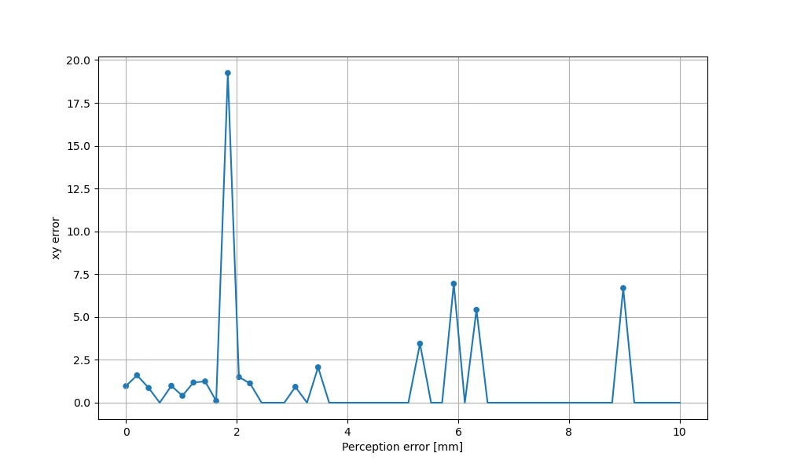
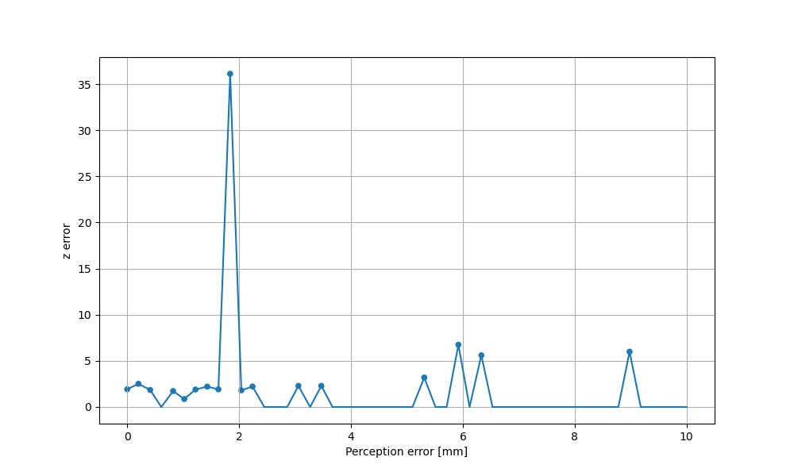
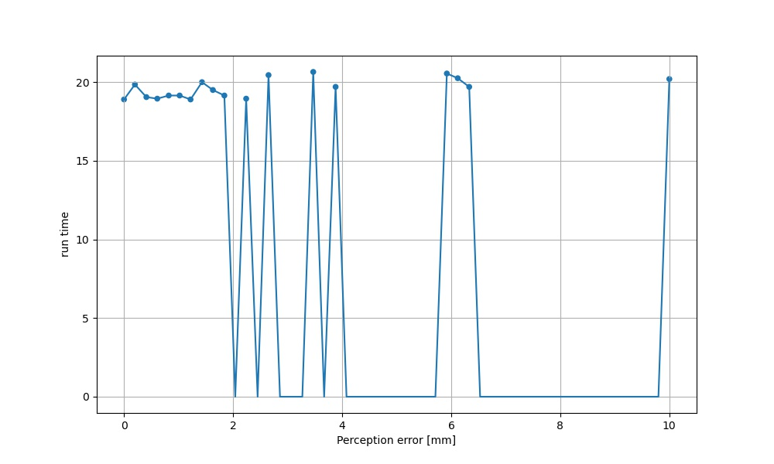
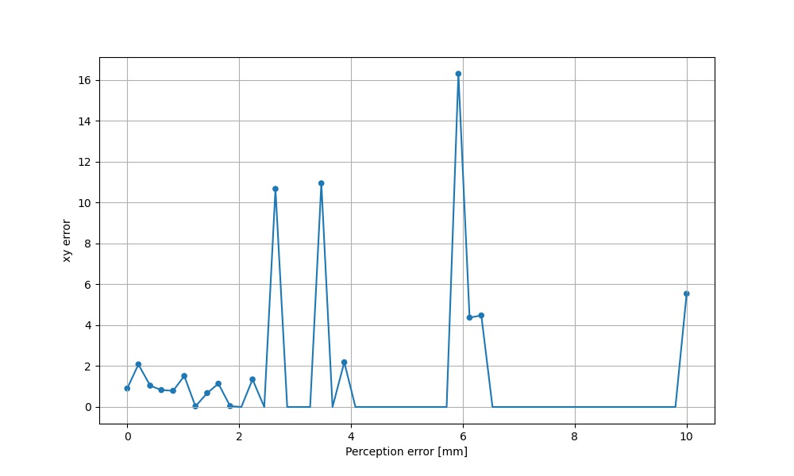
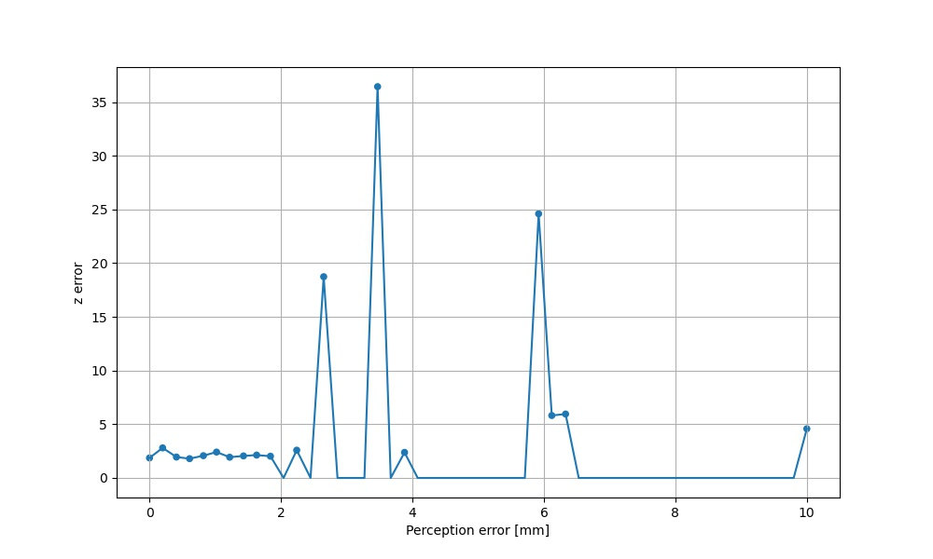
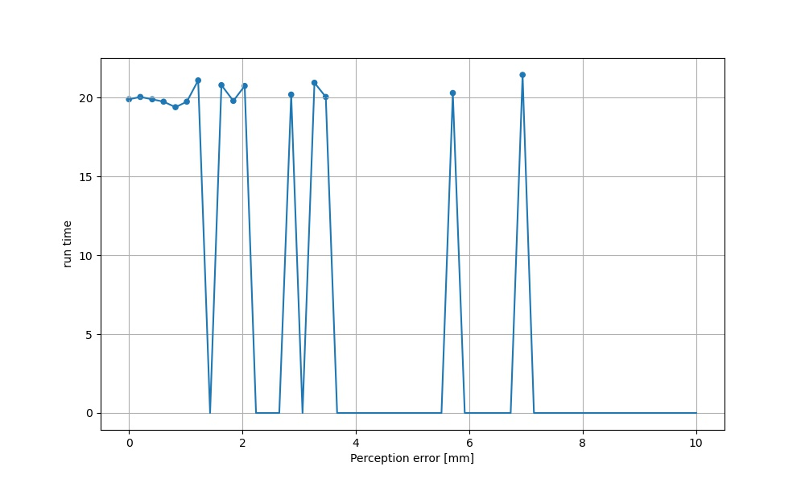
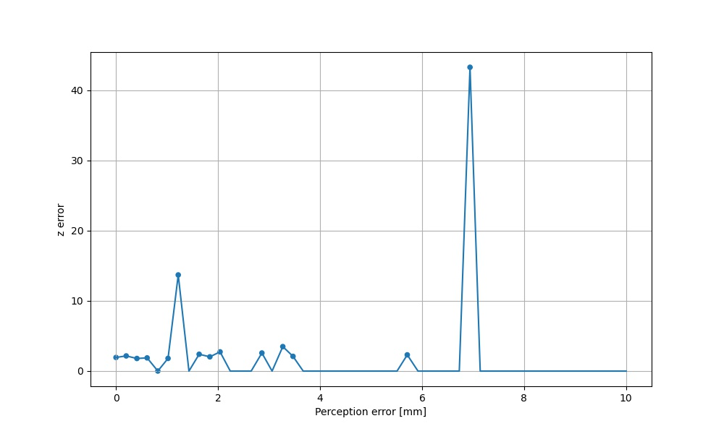
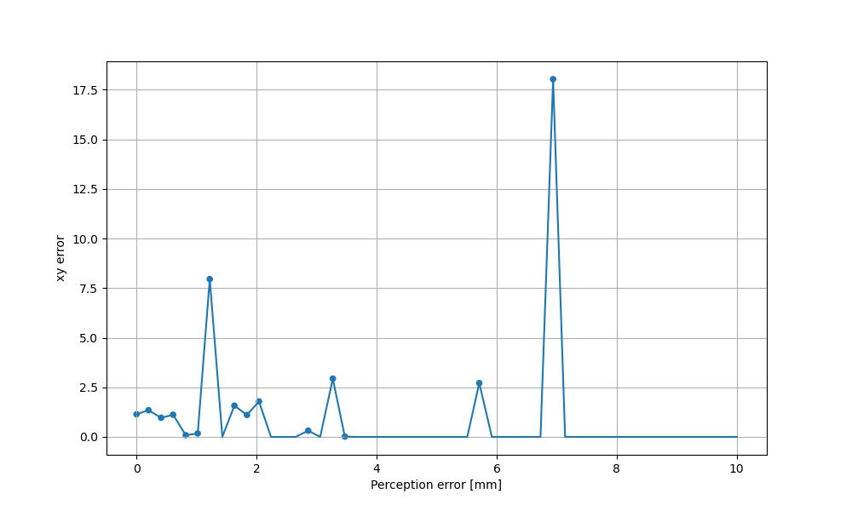
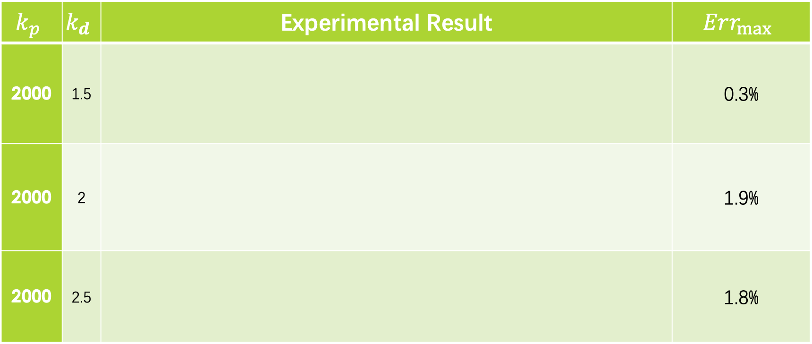
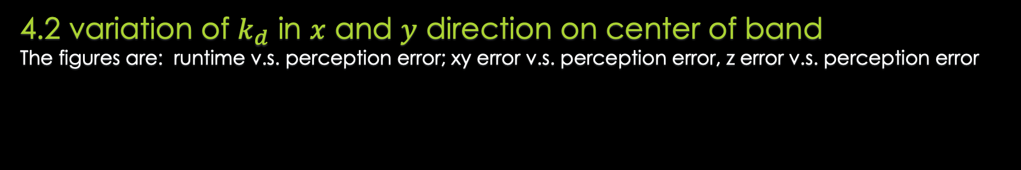
———————————————
Part 4: Experimental Results – Appendix
4.2 variation of $k_{d}$ in $x$ and $y$ direction on center of band
The figures are: runtime v.s. perception error; xy error v.s. perception error, z error v.s. perception error
$$k_{p}$$ | $$k_{d}$$ | Experimental Result | $$Err_{max}$$
2000 | 1.5 |  | 0.3%
2000 | 2 |  | 1.9%
2000 | 2.5 |  | 1.8%

Slide 21
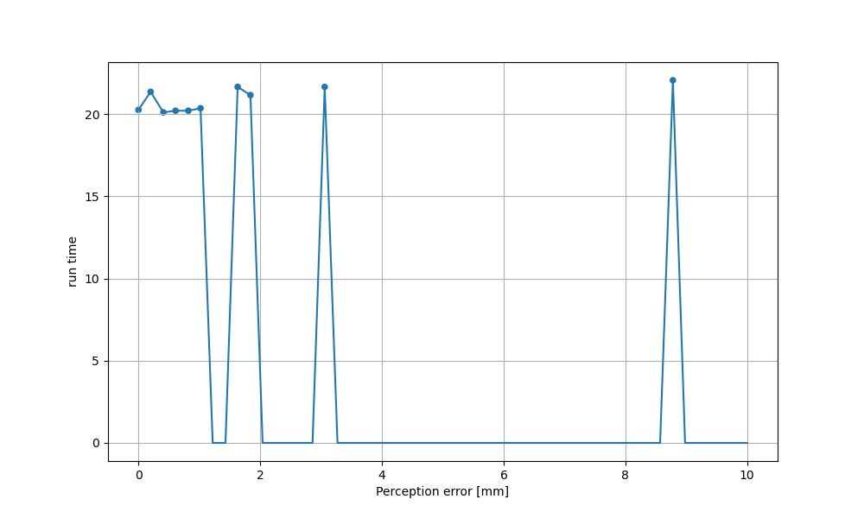
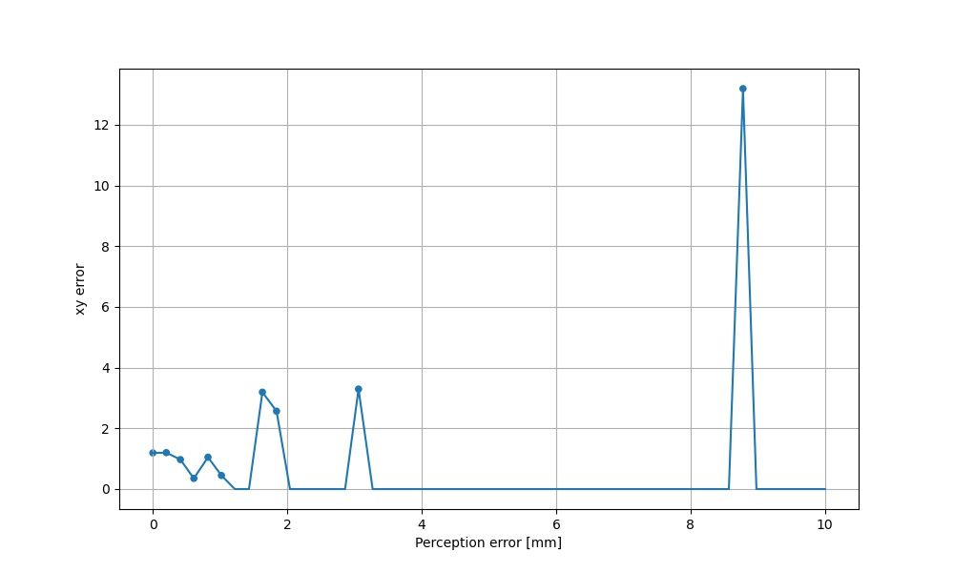
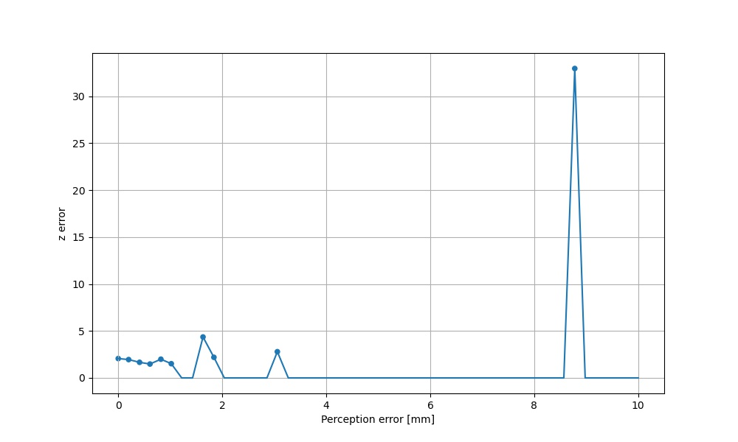
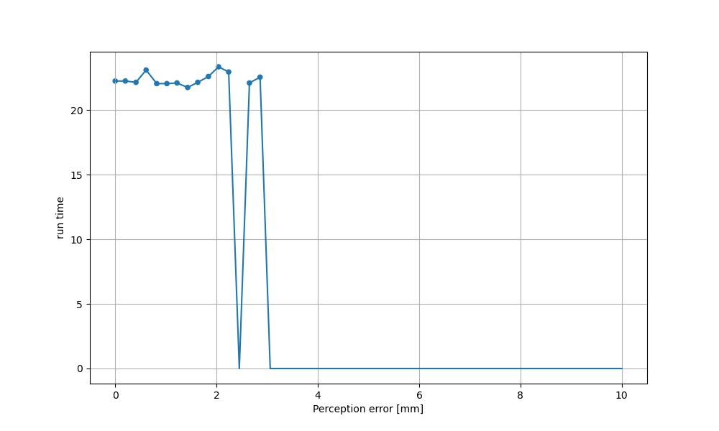
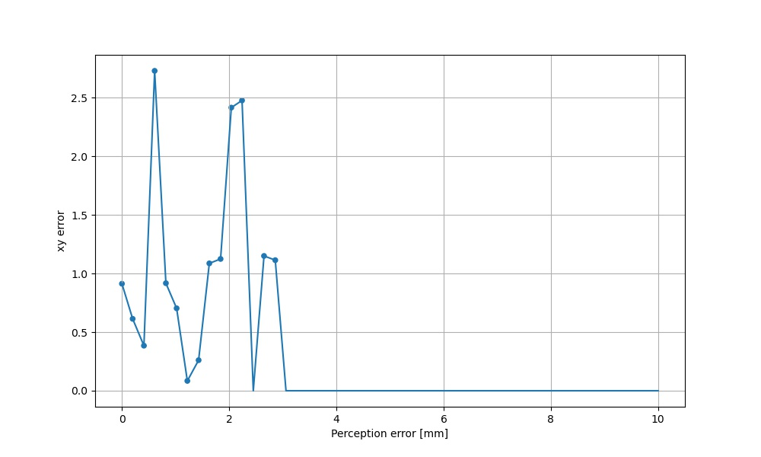
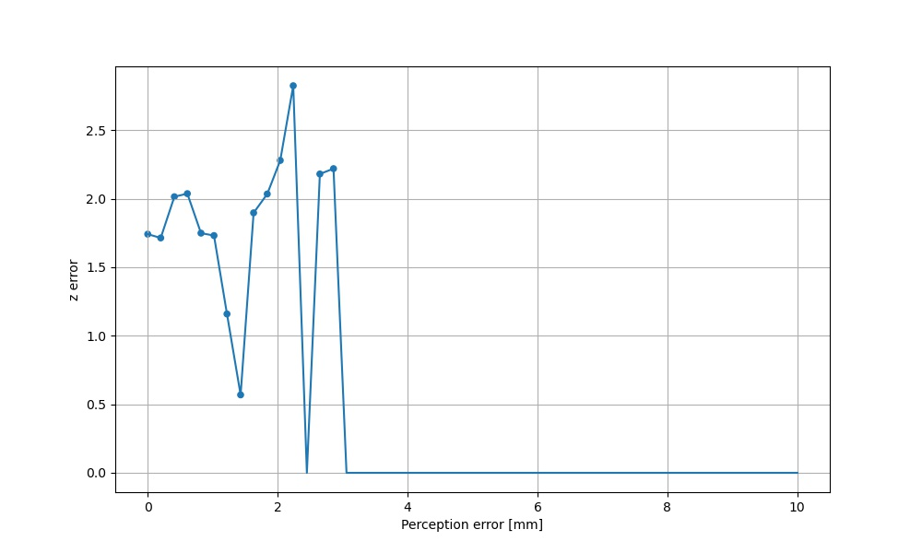
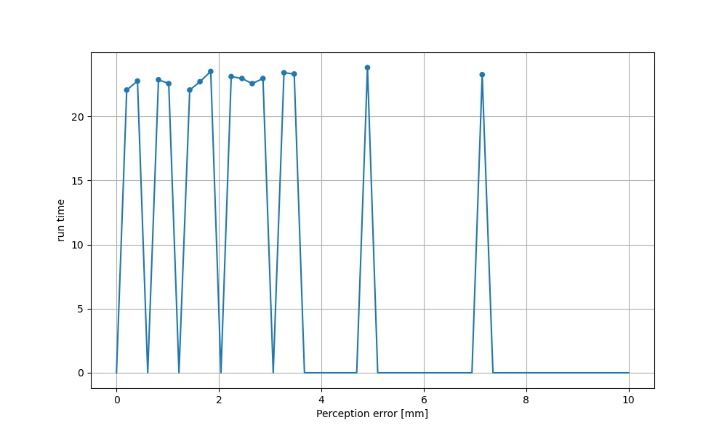
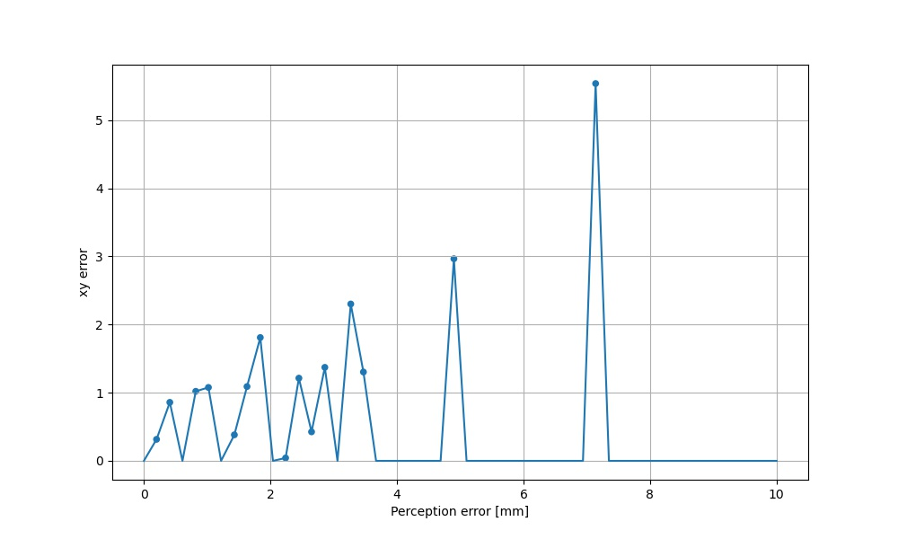
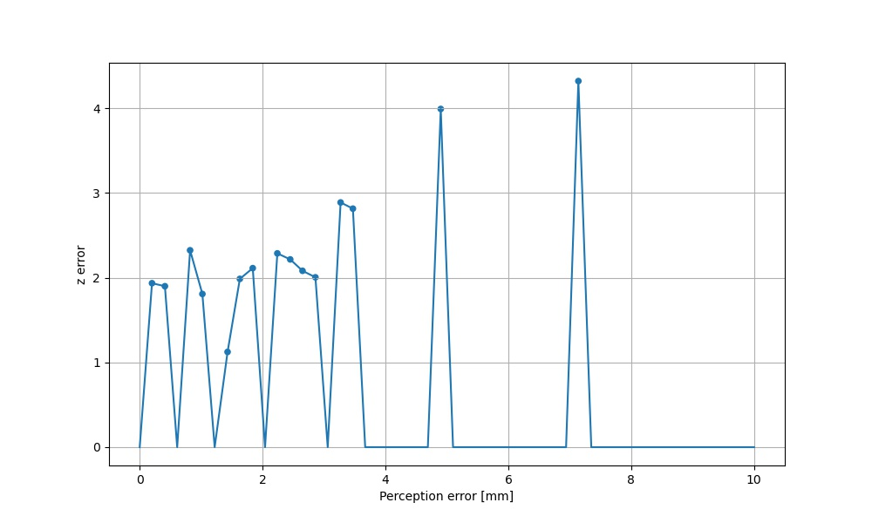


———————————————
Part 4: Experimental Results – Appendix
4.2 variation of $k_{p}$ and $k_{d}$ in $x$ and $y$ direction on band edges
The figures are: runtime v.s. perception error; xy error v.s. perception error, z error v.s. perception error
$$k_{p}$$ | $$k_{d}$$ | Experimental Result | $$Err_{max}$$
600 | 1.5 |  | 0.5%
1000 | 2.75 |  | 2.1%
2000 | 4 |  | 0.1%

Slide 22











———————————————
Part 4: Experimental Results – Appendix
4.2 variation of $k_{p}$ in $z$ direction
The figures are: runtime v.s. perception error; xy error v.s. perception error, z error v.s. perception error
$$k_{p}$$ | $$k_{d}$$ | Experimental Result | $$Err_{max}$$
450 | 4 |  | 2.2%
600 | 4 |  | 1.1%
750 | 4 |  | 1.8%

Slide 23








———————————————
Part 4: Experimental Results – Appendix
4.2 variation of $k_{d}$ in $z$ direction
The figures are: runtime v.s. perception error; xy error v.s. perception error, z error v.s. perception error
$$k_{p}$$ | $$k_{d}$$ | Experimental Result | $$Err_{max}$$
600 | 2 |  | 0.7%
600 | 4 |  | 1.1%
600 | 6 |  | 2.5%

Slide 24








———————————————
Part 4: Experimental Results – Appendix
4.2 variation of $k_{p}$ and $k_{d}$in $z$ direction that cross the band
The figures are: runtime v.s. perception error; xy error v.s. perception error, z error v.s. perception error
$$k_{p}$$ | $$k_{d}$$ | Experimental Result | $$Err_{max}$$
450 | 6 |  | 2.0%
600 | 4 |  | 1.1%
750 | 2 |  | 1.0%

